Slide 1


Tittle
"Analyzing Vital Signs and Their Predictive Role in Heart Attack Diagnosis: A Case Study from Zheen Hospital, Erbil, Iraq"

Slide 2
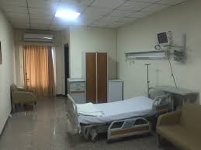
Table of content
Introduction
Methodology
Objective
Visual Representation
Insights
Recommendation
Conclusion

Slide 3
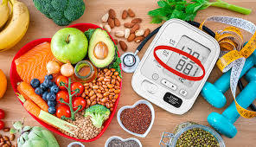
Introduction This Study shows how Cardiovascular diseases are among the leading causes of death globally, with heart attacks representing a major contributor to mortality rates.
Goals
Focus
Early detection of cardiovascular conditions through routine clinical measurements, including blood pressure, blood sugar, and cardiac biomarkers (CK-MB and Troponin), plays a critical role in improving patient outcomes. This study investigates the patterns of these vital signs across various age groups and genders. Furthermore, it examines the correlation between these measurements and the results of heart attack diagnoses. The ultimate goal of this research is to contribute to strategies that reduce mortality rates associated with cardiovascular diseases.
Identify the cause of high Cardiovascular in Gender
At what age are we prone to have Cardiovascular Disease
Find solution on how to prevent Cardiovascular it

Slide 4



Methodology
Data Profiling
Data Visualization
Data Source

Slide 5
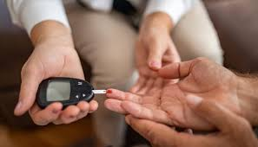
Objectives
To analyze vital signs and biochemical markers such as blood pressure, glucose, CK-MB, and troponin levels in relation to heart attack diagnosis outcomes, with the aim of identifying predictive patterns across age groups and genders using data from Zheen Hospital, Erbil, Iraq (Jan–May 2019).

Slide 6
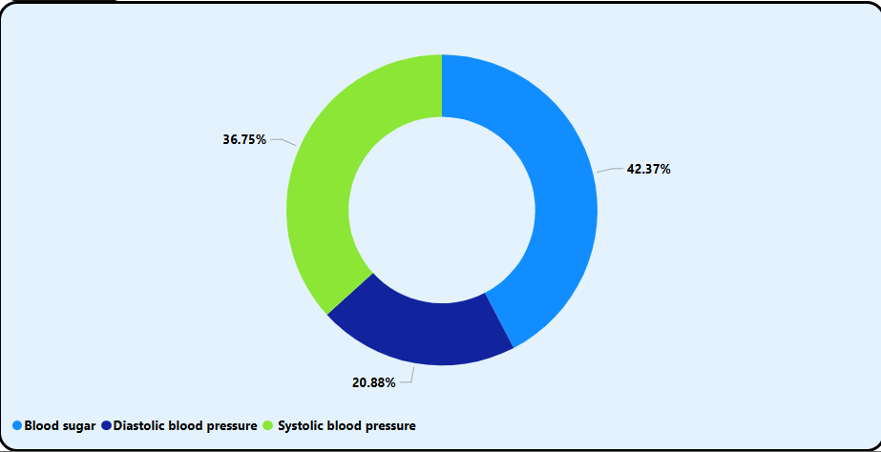
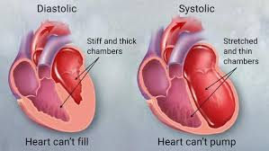
Analysis
Systolic BP makes up the largest portion (42.37%), followed by Diastolic BP (36.75%) and Blood Sugar (20.88%).

Slide 7
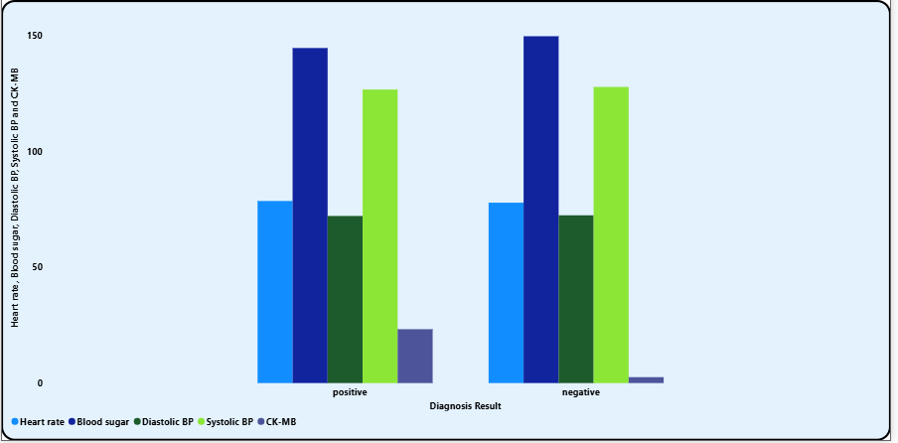
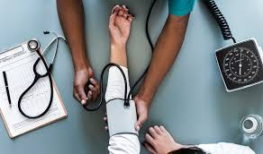
Positive diagnosis cases generally show higher average readings across all metrics
(heart rate, BP, blood sugar) compared to negative cases.

Slide 8
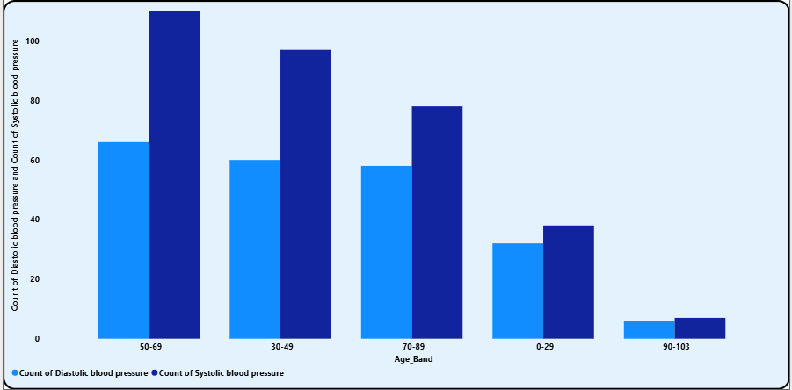
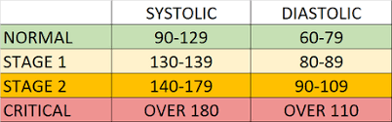
With this it’s show that people that have systolic blood pressure are more than Diastolic blood pressure.

Slide 9
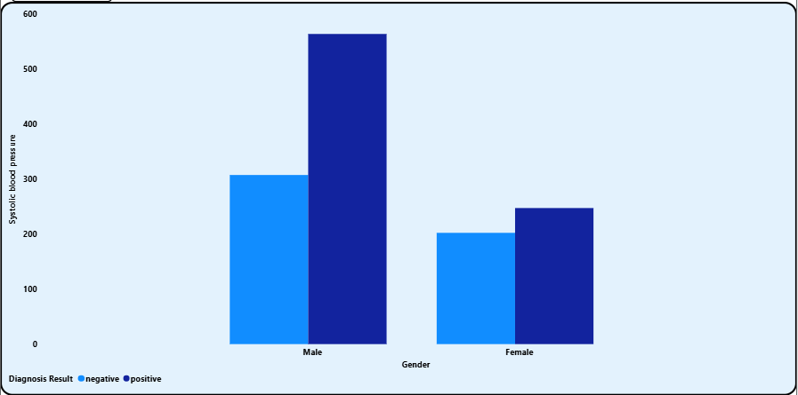
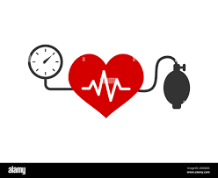
Males with a positive diagnosis exhibit significantly higher systolic blood pressure.

Slide 10
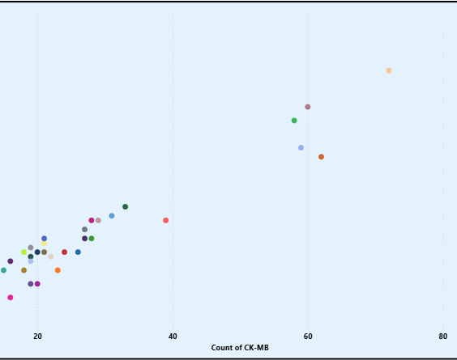
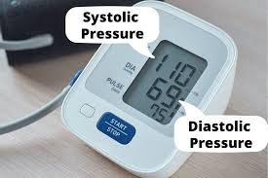
A strong positive correlation is visible between CK-MB and Troponin, both of which increase together with age key biomarkers in heart attack diagnosis.
The age 60 range shows particularly high counts, indicating older individuals have elevated cardiac biomarker levels.

Slide 11
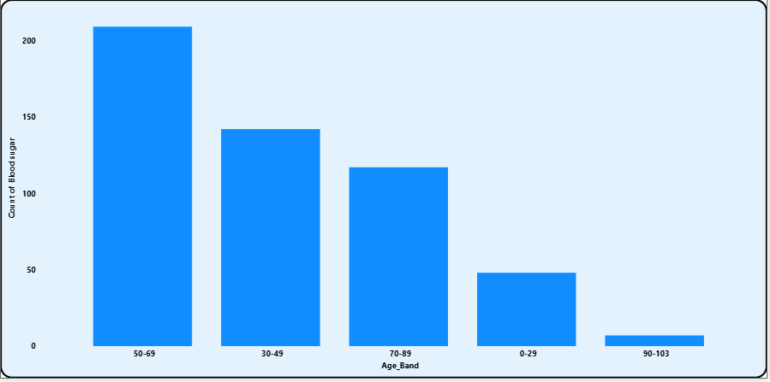
The 50–69 age group has the highest count of elevated blood sugar, suggesting middle-aged patients may be more prone to glucose related complications.

Slide 12
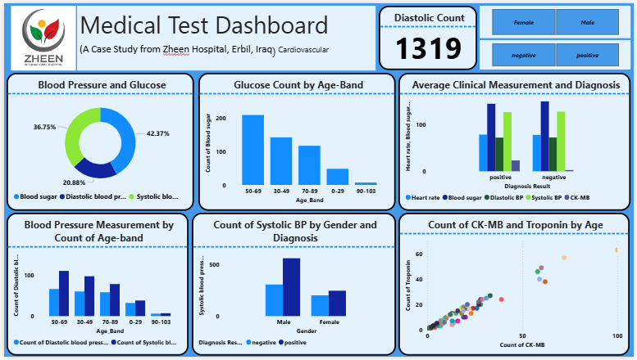
Dashboard

Slide 13
insight
Vital Signs Frequency:
Diastolic and systolic BP were most measured; blood sugar was least.
Age Patterns:
Age group 50–69 had highest counts for glucose and BP, high-risk group.
Gender & Diagnosis:
Males with positive diagnosis had higher systolic BP than females.
Diagnosis vs Clinical Values:
Positive heart attack cases had higher heart rate, blood sugar, and BP.
CK-MB & Troponin:
Strong correlation reliable markers for heart attack diagnosis.

Slide 14

Recommendation
Prioritize Middle-Aged Patient Monitoring (50–69 years)
Given high glucose and blood pressure counts, preventive screenings should be intensified for this age group.
Gender-Specific Interventions
Tailor awareness campaigns and clinical protocols to address higher systolic BP in males with positive diagnoses.
Use Biomarker Monitoring for Early Detection
CK-MB and Troponin are strongly correlated and should be used jointly for early and accurate diagnosis in suspected heart attack cases.
Enhance Data Tracking by Diagnosis Outcome
Clinical records should ensure consistent tagging of results to better distinguish trends between positive and negative diagnosis outcomes.

Slide 15
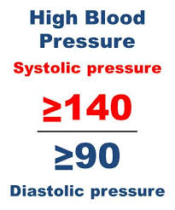
Conclusion
This dashboard offers a comprehensive view of how vital signs relate to heart attack diagnosis. Key patterns indicate that age (50–69), male gender, and elevated CK-MB/Troponin levels are significant indicators of heart attack risk. By leveraging this data-driven insight, Zheen Hospital can optimize patient screening and care protocols, leading to improved cardiovascular outcomes.

Slide 16
Thank You

